Slide 1
Customer Retention & Cohort Analysis with the Modern Data Stack
July 9, 2025

Slide 2
Project Overview
In this project, we analyzed customer retention and repeat purchases using modern tools:
Fivetran to ingest data from GCP Cloud SQL
Databricks to transform and model the data (Delta Lake, SQL)
Dashboards to visualize cohort trends
We focused on:
When customers return to buy again
How retention differs across monthly cohorts
What insights we can use to improve marketing
.

Slide 3
Data Pipeline
How the Data Flows
Data Ingestion: Fivetran pulls e-commerce sales data from GCP Cloud SQL into Delta Lake in Databricks
Data Transformation: SQL in Databricks is used to:
Find each customer’s first and second purchase dates
Group customers into cohorts by first purchase month
Visualization: Dashboards in Databricks show retention trends and repeat purchase behavior

Slide 4

What Is a Cohort?
A cohort is a group of customers who made their first purchase in the same month.
We then track:
How many of them made a second, third, or fourth purchase
How quickly they returned
This helps us understand how customer behavior changes over time.

Slide 5
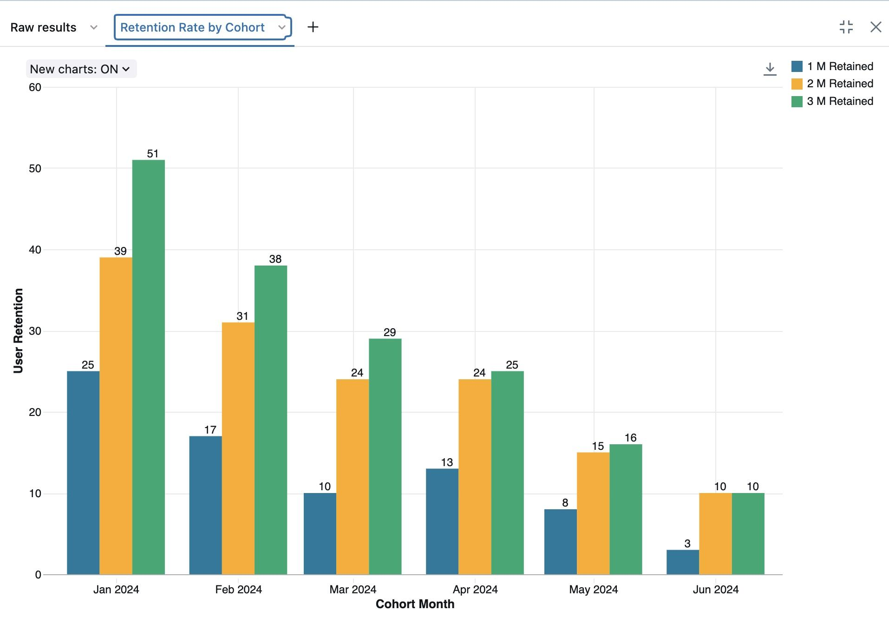
Visualization 1 –
Retention Rate by Cohort
1-Month Retention:
Highest: May 2024 (50%)
2-Month Retention:
Highest: June 2024 (100%) (only 10 customers – small sample)
3-Month Retention:
Highest: May & June 2024 (100%)
Observation:
Newer cohorts (Apr–Jun) show better short-term retention
Older cohorts (Jan–Mar) had lower early retention (~30–38%)

Slide 6
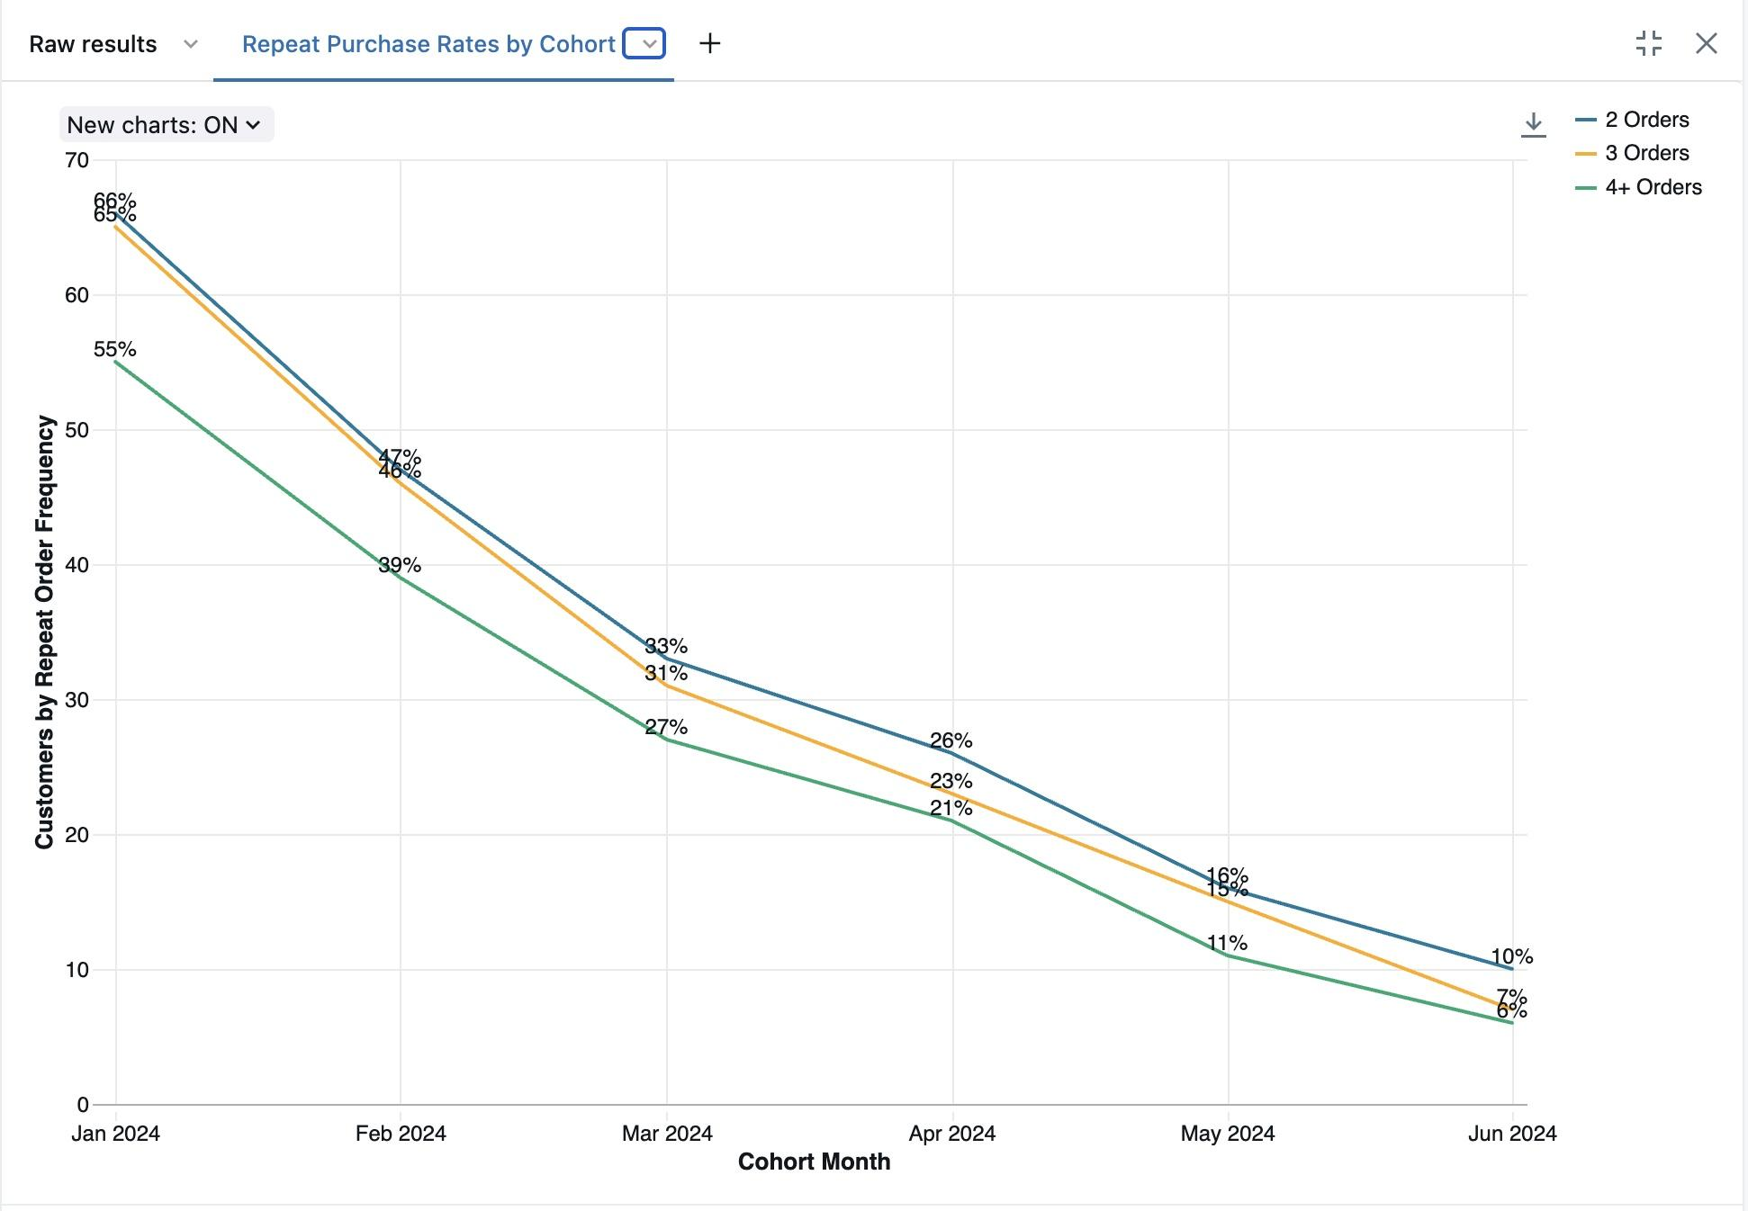
Visualization 2 –
Repeat Purchase by Cohort
2nd Purchase Rate:
Very high (96–100%) across all cohorts
3rd Purchase Rate:
Declines over time: Jan (98.5%) → Jun (70%)
4th Purchase Rate:
Clear drop: Jan (83.3%) → Jun (60%)
Interpretation:
Older cohorts (Jan–Mar) had stronger long-term loyalty
Newer cohorts make fewer follow-up purchases

Slide 7
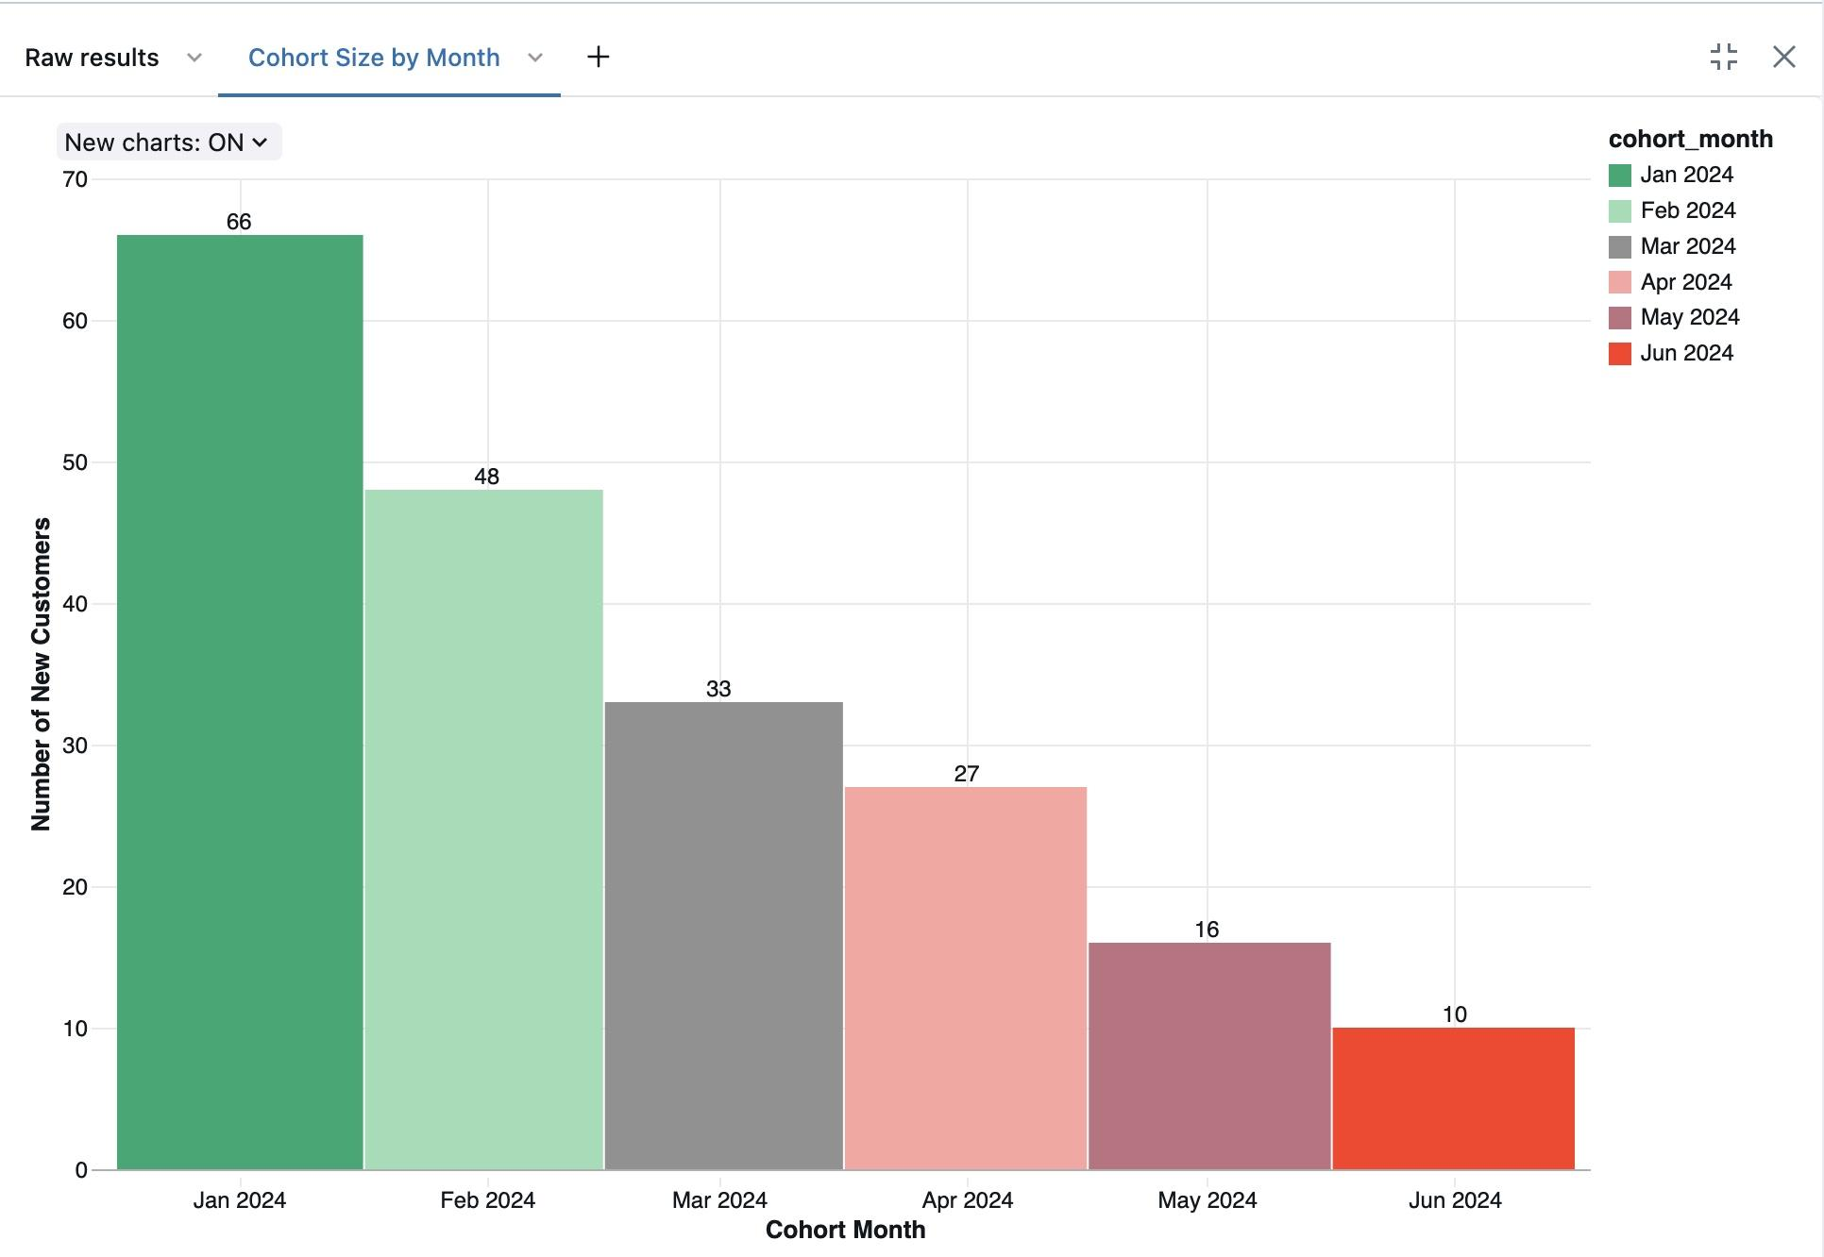
Visualization 3 –
Cohort Size by Month
New customer numbers are going down each month:
January 2024: 66 customers (peak month)
June 2024: only 10 customers
This shows a steady drop in new acquisitions, month over month.

Slide 8
Summary of Insights
Retention is improving in the short term for newer cohorts
Repeat purchase rates are declining after the 2nd order
Older cohorts had stronger long-term engagement
New customer acquisition is slowing down
These insights help us improve:
Customer retention strategies
Marketing campaigns
User experience

Slide 9
Conclusion
This project showed how tools like Fivetran and Databricks can work together to build a scalable, automated cohort analysis solution. It provided key insights into retention patterns and helped identify opportunities for marketing and product strategy improvements.
By understanding customer behavior over time, the company can take data-driven actions to improve retention, engagement, and long-term value.
.

